Slide 1
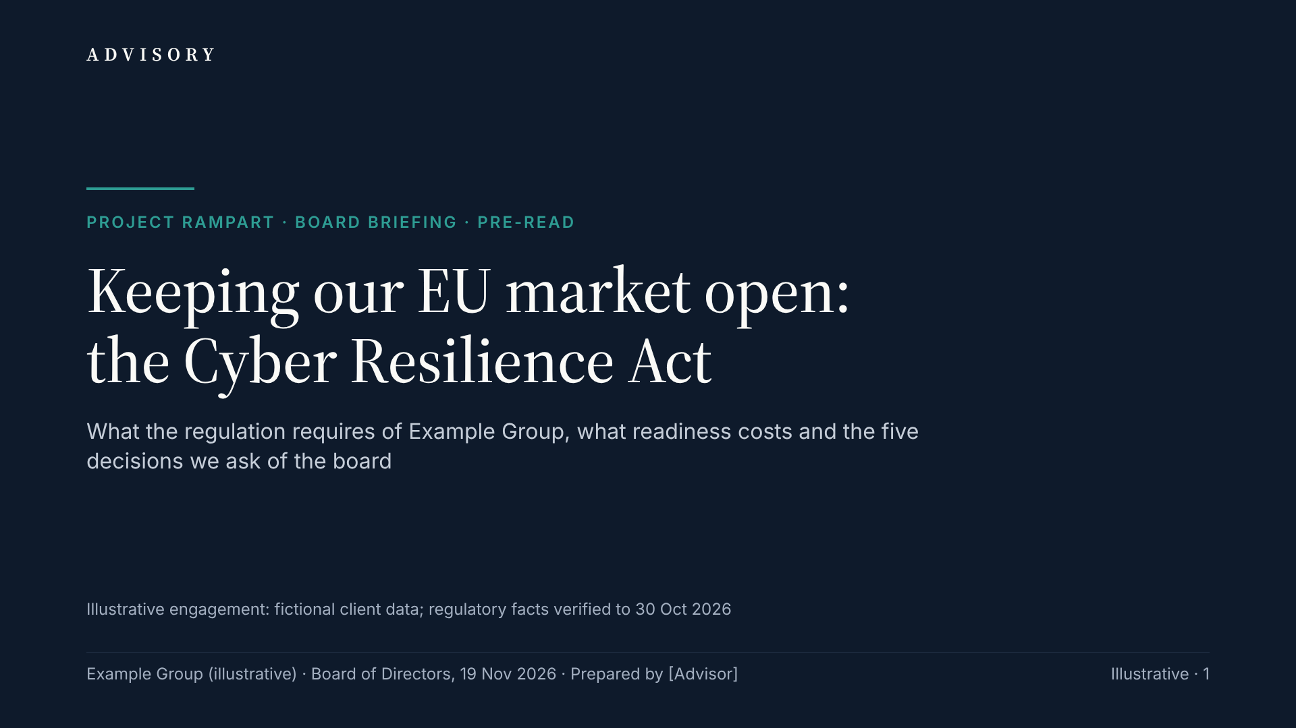
Notes:
This pre-read supports a 30-minute board discussion. The Cyber Resilience Act turns product cybersecurity into a condition of selling connected products in the EU. Its reporting duty already applies; everything else applies from 11 December 2027, 387 days from today. The action titles alone tell the story: what the law requires, where we are exposed, how ready we are, what we propose, what it costs and what we ask of you. We ask for five decisions today. All client figures are illustrative; regulatory facts are verified to 30 October 2026.

Slide 2
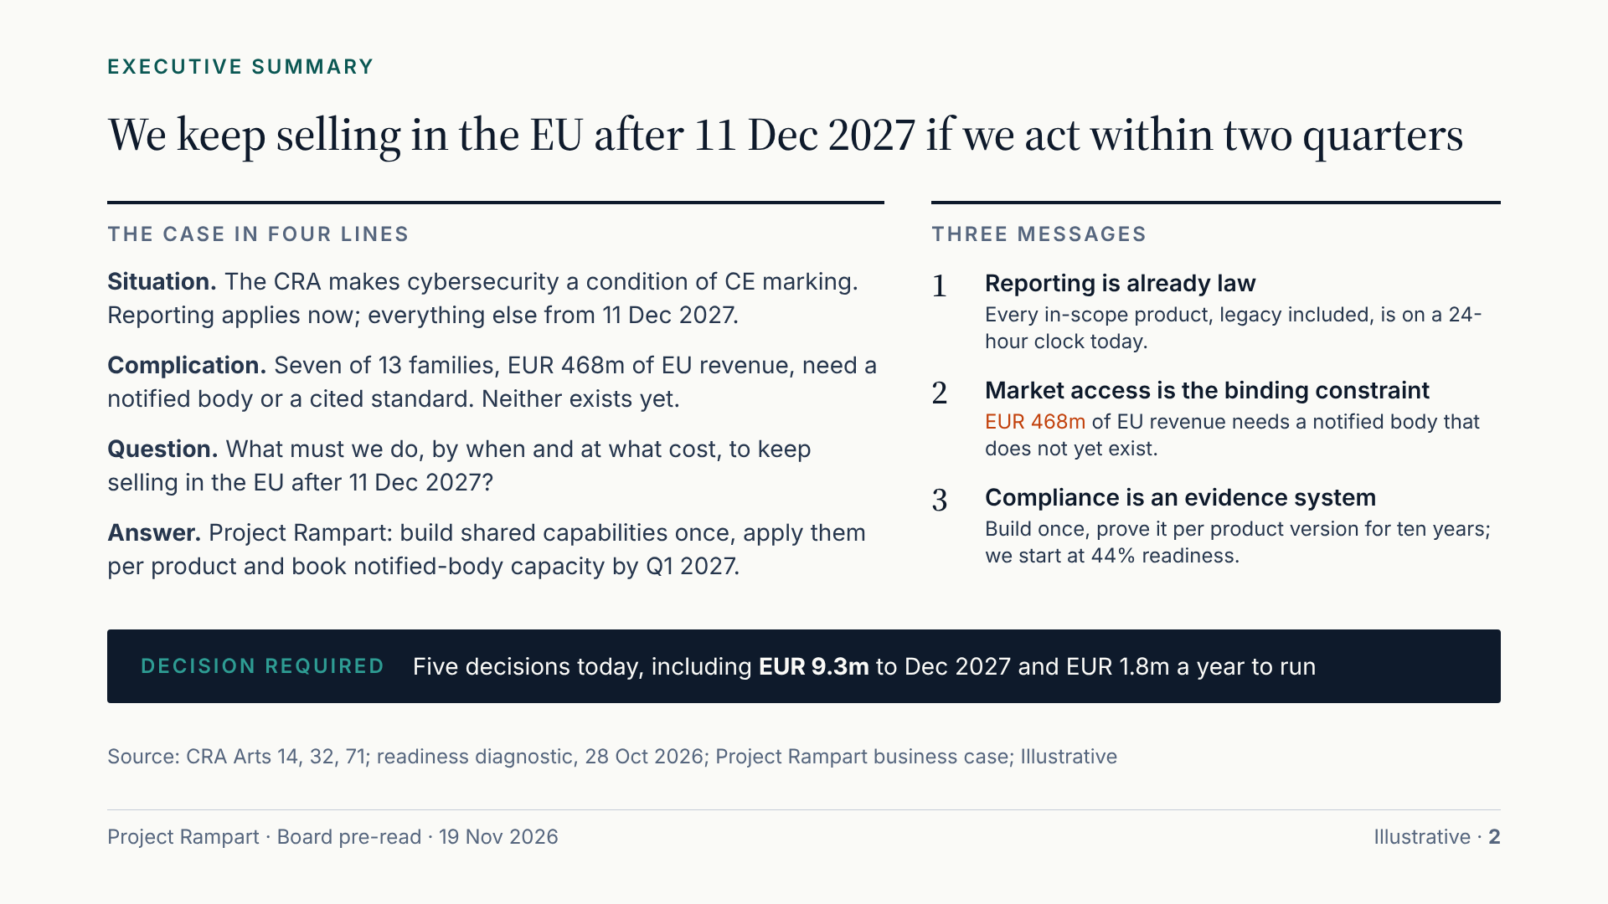
Notes:
If you read one slide, read this one. The situation: the CRA is in force and its reporting duty already covers every product we have sold. The complication: seven families carrying EUR 468m of EU revenue cannot be self-certified today, because no harmonised standard is cited and no notified body was designated at checks to 8 Sep 2026, and our readiness is 44%. Our answer is Project Rampart, a 14-month programme that builds shared capabilities once, applies them product by product and secures notified-body capacity by the end of Q1 2027. It costs EUR 9.3m to December 2027 and EUR 1.8m a year after that. We ask for five decisions today.

Slide 3
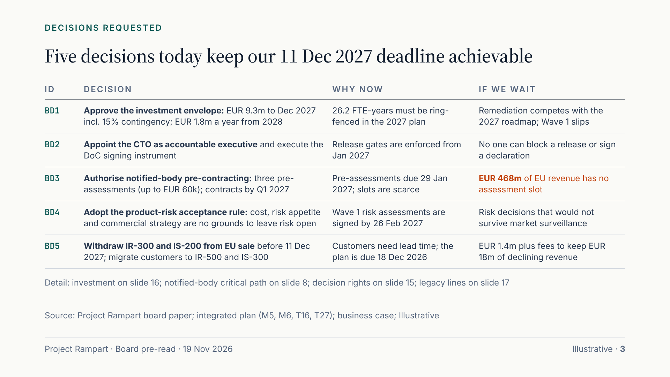
Notes:
These are the five decisions we need today; every slide that follows supports at least one of them. BD1 releases the investment envelope. BD2 names the CTO as accountable executive and makes the declaration signature a controlled authority. BD3 lets us book notified-body capacity before any body is designated, the most time-critical action in the plan. BD4 changes how product risk is accepted, because the Commission’s guidance rules out cost as a reason. BD5 withdraws two declining legacy lines instead of spending about EUR 1.4m to remediate them. A quarter’s delay on any of them uses up the slack we have.

Slide 4
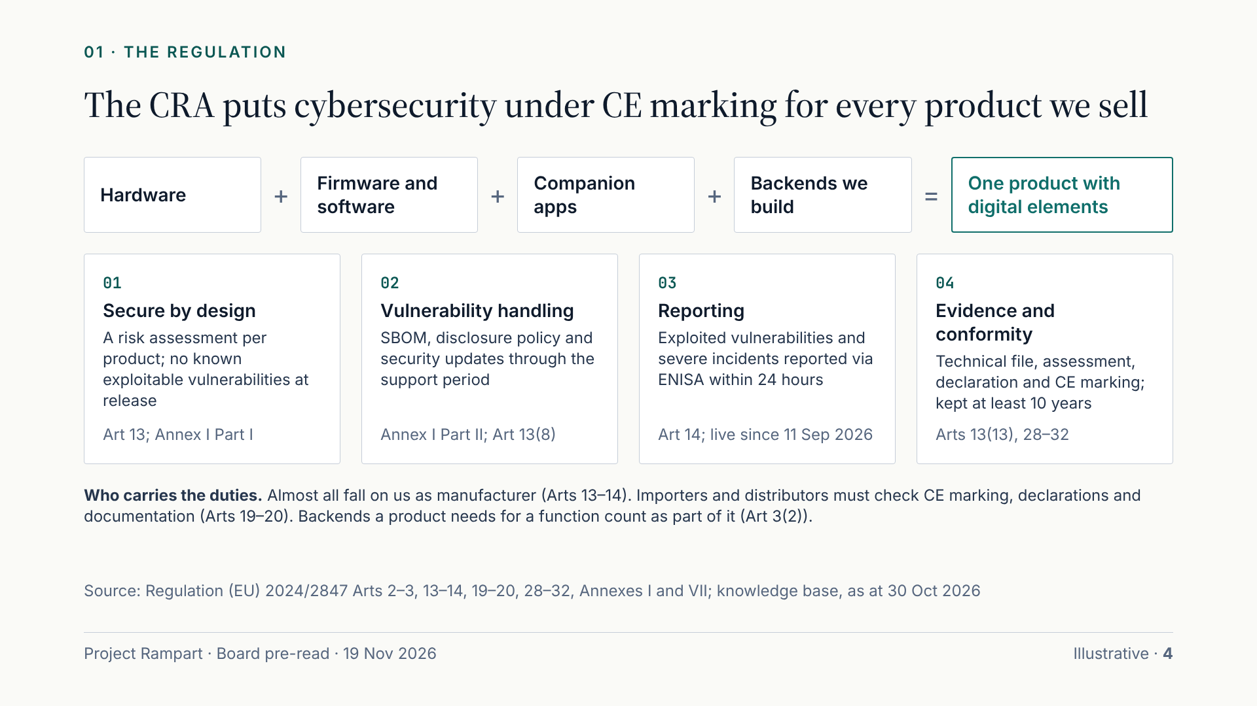
Notes:
The CRA is a product law, not an IT-security law. It covers anything with digital elements that connects to a device or network and is sold in the EU, to businesses or consumers. For us, the product is the device plus its firmware, its app and the cloud services we build that it needs to work. Four groups of duties follow: design it securely, handle its vulnerabilities for the whole support period, report exploited vulnerabilities and severe incidents within 24 hours, and prove all of it in a technical file before CE marking. As manufacturer, we carry almost all of it.

Slide 5
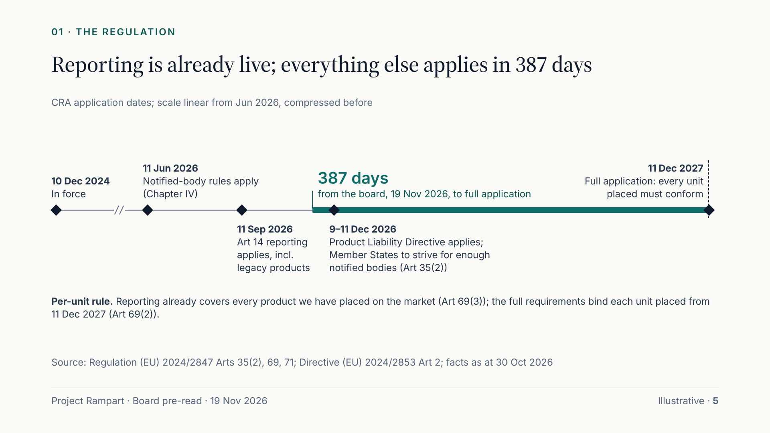
Notes:
The dates are fixed in the regulation. It entered into force in December 2024. The rules for notified bodies have applied since June 2026, yet none had been verifiably designated at the last check. Reporting has applied since 11 September 2026, and it covers every in-scope product we have ever placed on the market, not only new ones. In three weeks the new Product Liability Directive applies, which treats software as a product. From 11 December 2027 every unit we place on the EU market must conform. That is 387 days from today.

Slide 6
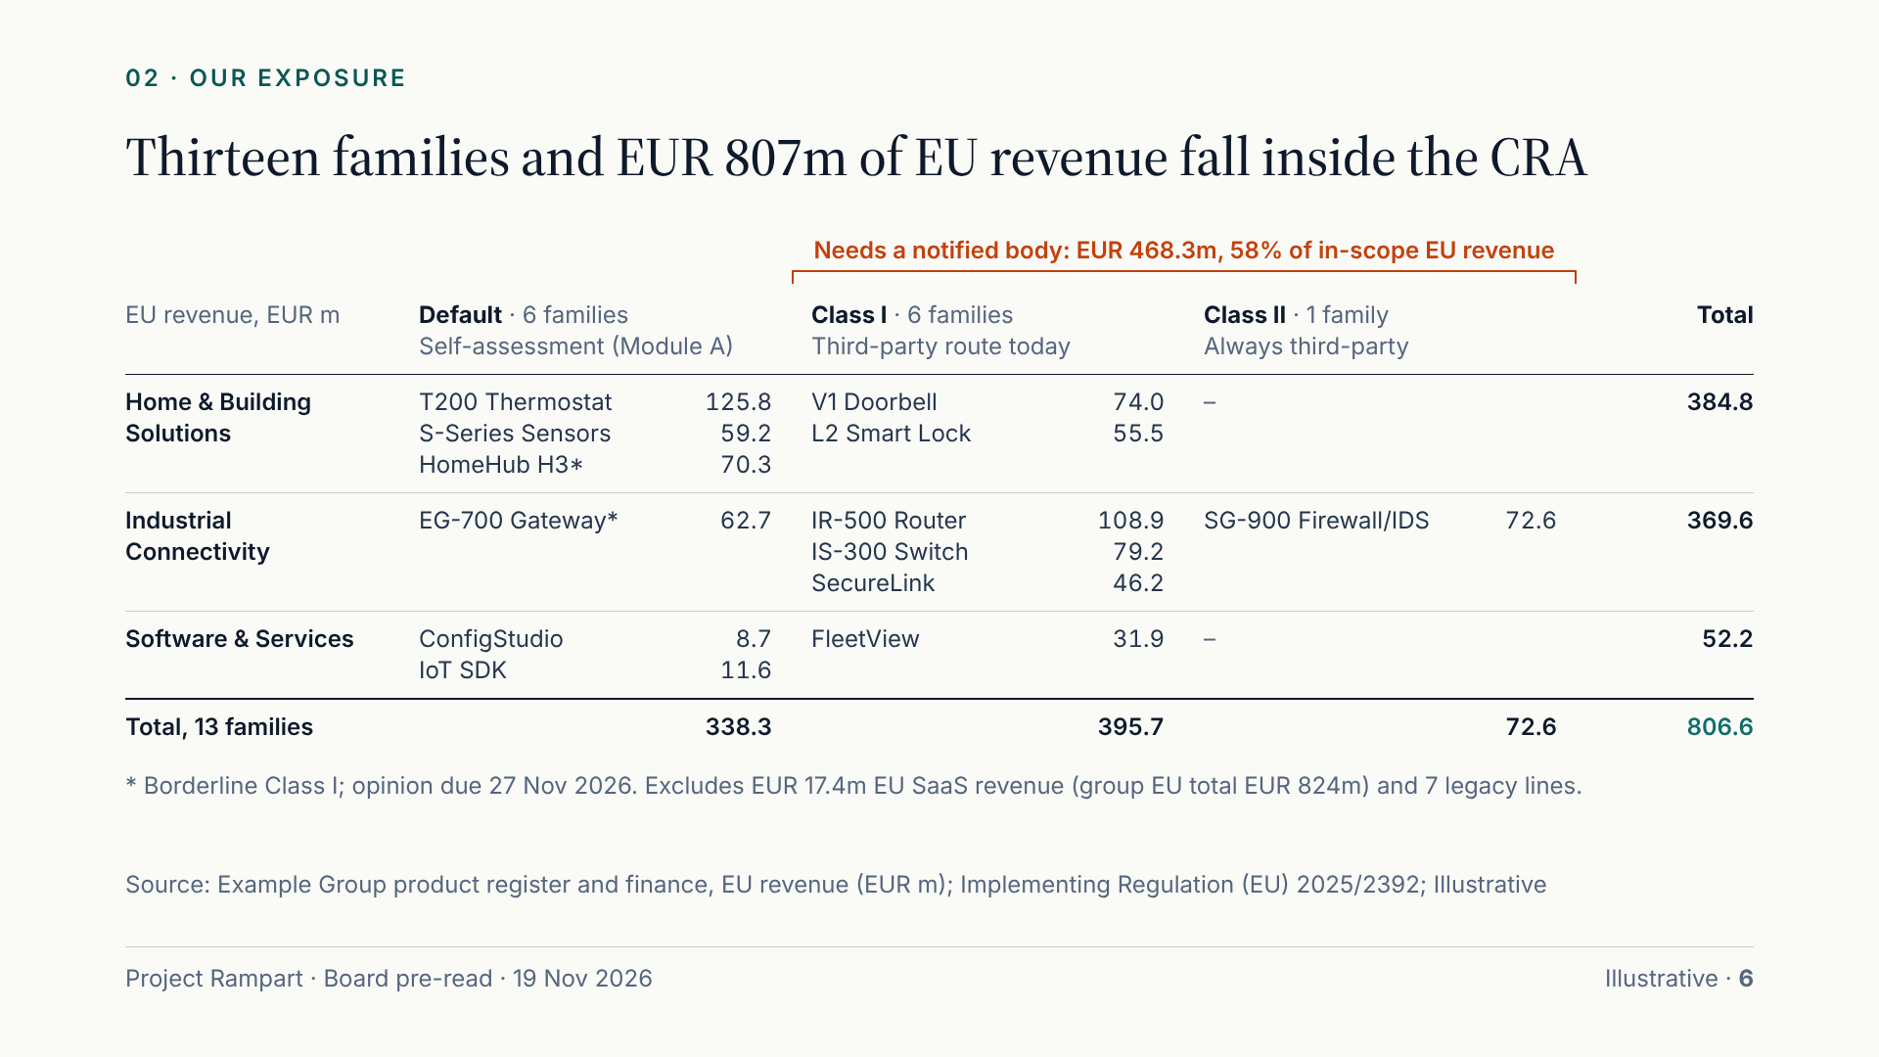
Notes:
This is our exposure on one page: thirteen product families, 55 SKUs, three business units, all in scope. Six are default products that we may self-assess, although two of them, HomeHub H3 and the EG-700 gateway, are borderline Class I pending a legal opinion due on 27 November. Six are Class I and one, the SG-900 firewall, is Class II; those seven need third-party assessment. In-scope EU revenue is EUR 807m of our EUR 824m total; the rest is SaaS revenue, which is not itself a product. Seven legacy lines, including 1.1 million T100 thermostats, also remain reportable.

Slide 7
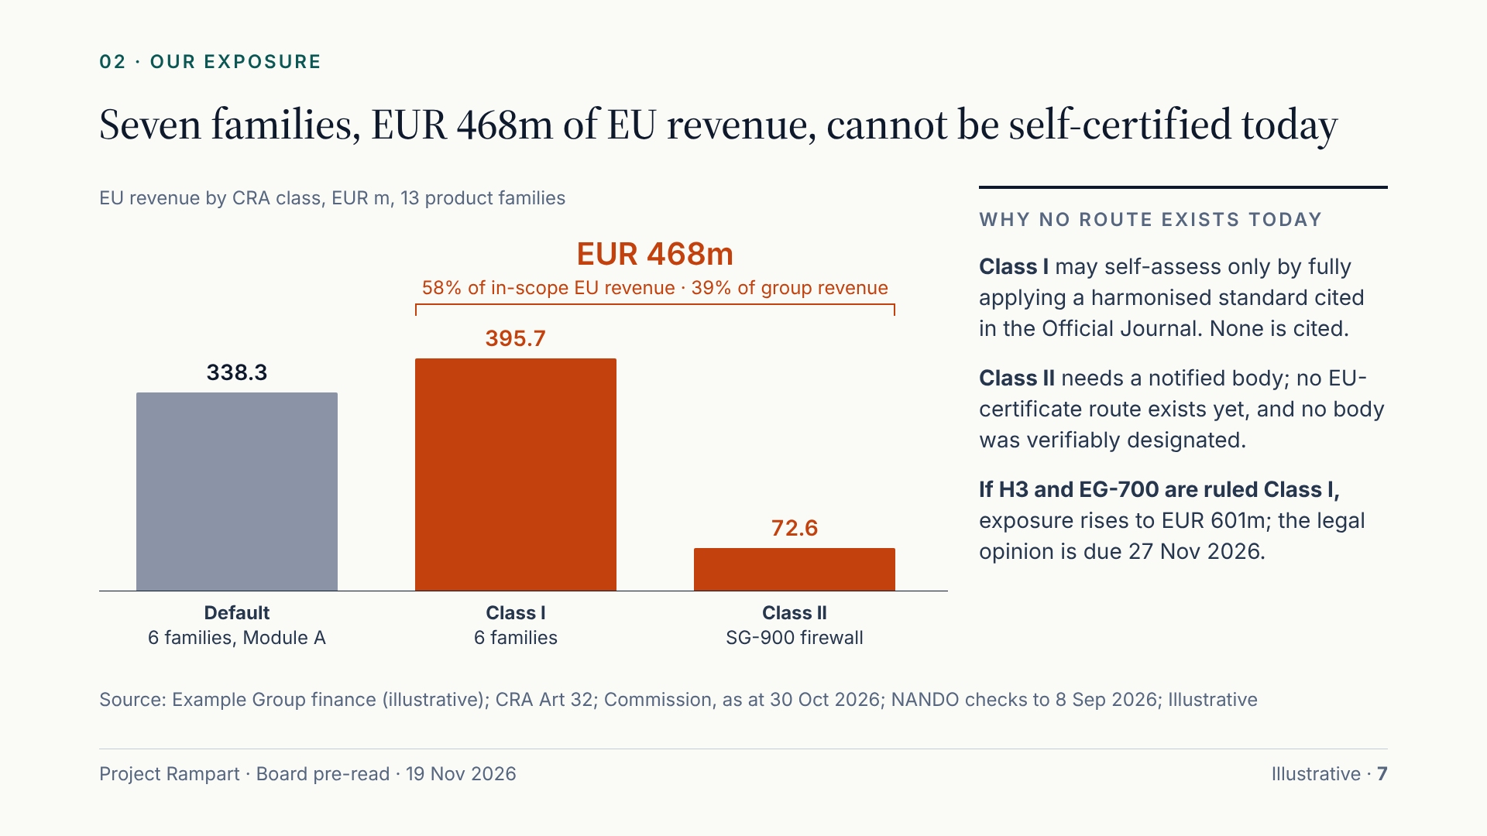
Notes:
This is the binding constraint. Class I products may self-certify only by applying a harmonised standard cited in the Official Journal; none is cited, and the first are expected in 2027 at the earliest. Class II products always need a notified body, and none had been verifiably designated at the last check. Together that is EUR 468m of EU revenue, 39% of group revenue, with no route to market today. If the legal opinion classifies HomeHub H3 and EG-700 as Class I, the figure rises to EUR 601m, which is why both are already in our notified-body capacity planning.

Slide 8
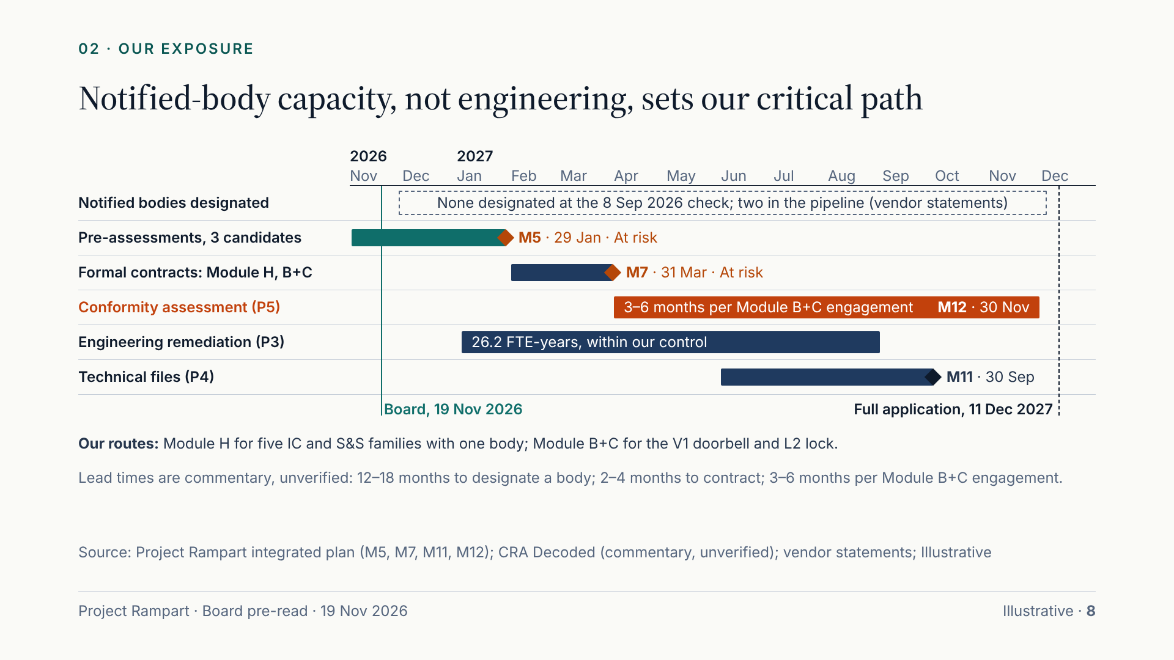
Notes:
Engineering is hard but within our control; notified-body capacity is not. Working back from 11 December 2027: certificates must be in hand by 30 November; a Module B+C engagement takes three to six months once started; contracting a body takes two to four. Those are commentators’ estimates, not verified, but they put our contracting deadline at the end of Q1 2027. Bodies themselves take 12 to 18 months to be designated, and none was confirmed at checks to 8 Sep 2026. Our mitigation: Module H for the five industrial and software families, so one body covers them, and pre-assessments with three candidates now.

Slide 9
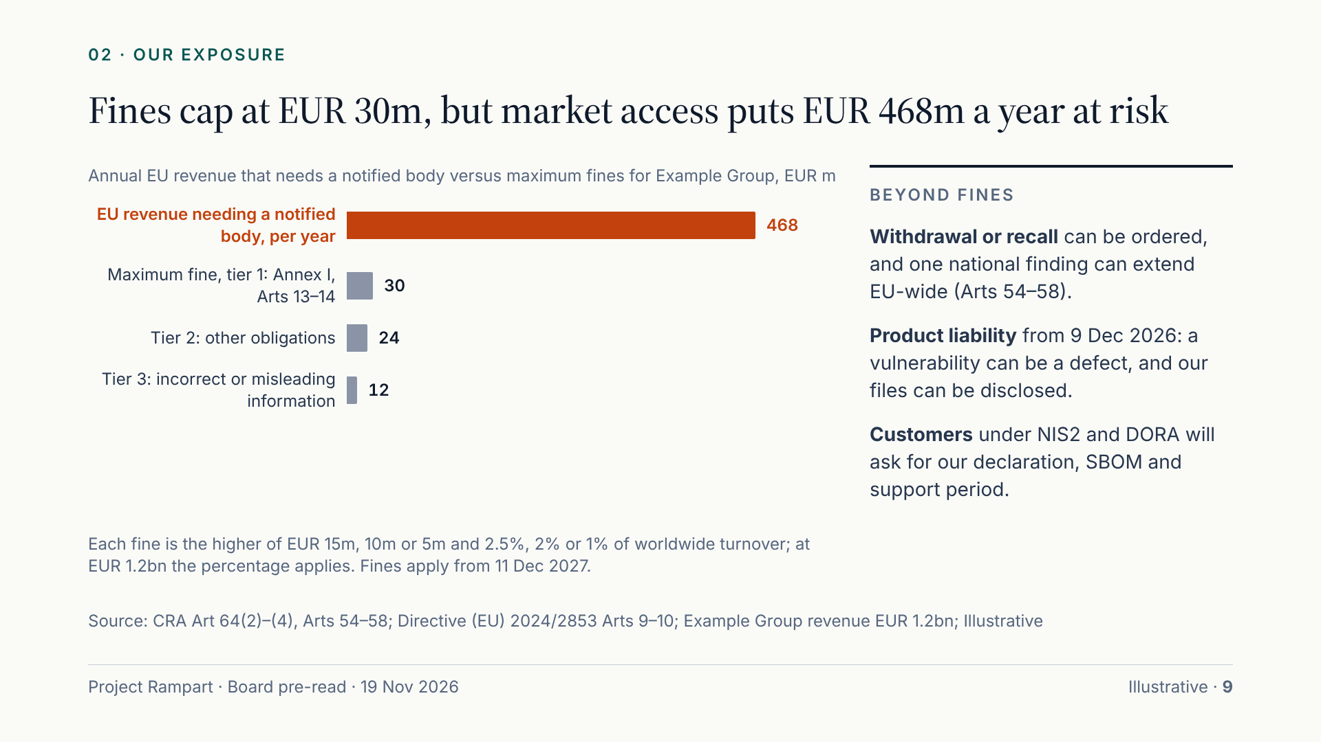
Notes:
Fines matter but are not the main exposure. At our turnover the top tier is 2.5%, EUR 30m, for breaches of the essential requirements or the reporting duty; the lower tiers are EUR 24m and EUR 12m. The larger risk is commercial: a product without a completed conformity assessment cannot be placed on the market, and authorities can order withdrawal or recall, across the EU. For the seven families that need a notified body, that is EUR 468m of revenue a year. Two second-order effects add pressure: product-liability claims from December, and customers asking for our evidence.

Slide 10
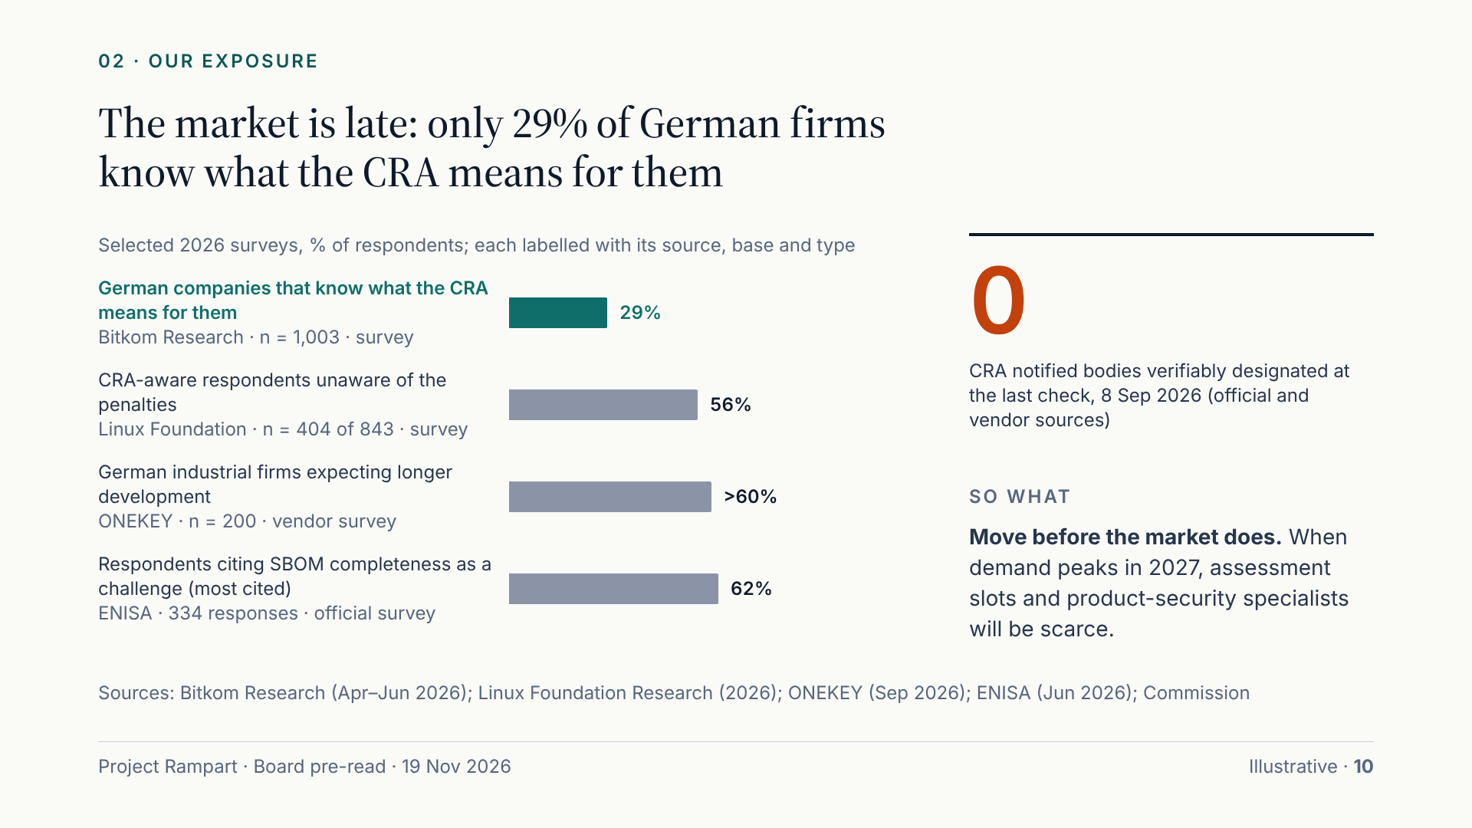
Notes:
The wider market is behind. Only 29% of German companies say they know what the CRA means for them. More than half of CRA-aware respondents in the Linux Foundation survey do not know the penalties. Most industrial firms expect longer development, and SBOM completeness is the top challenge reported to ENISA. These surveys vary in quality, so each is labelled by type and base. The implication is urgency, not comfort: when the market moves in 2027, notified-body slots and experienced product-security staff will be scarce. Moving now lets us book capacity before demand peaks.

Slide 11
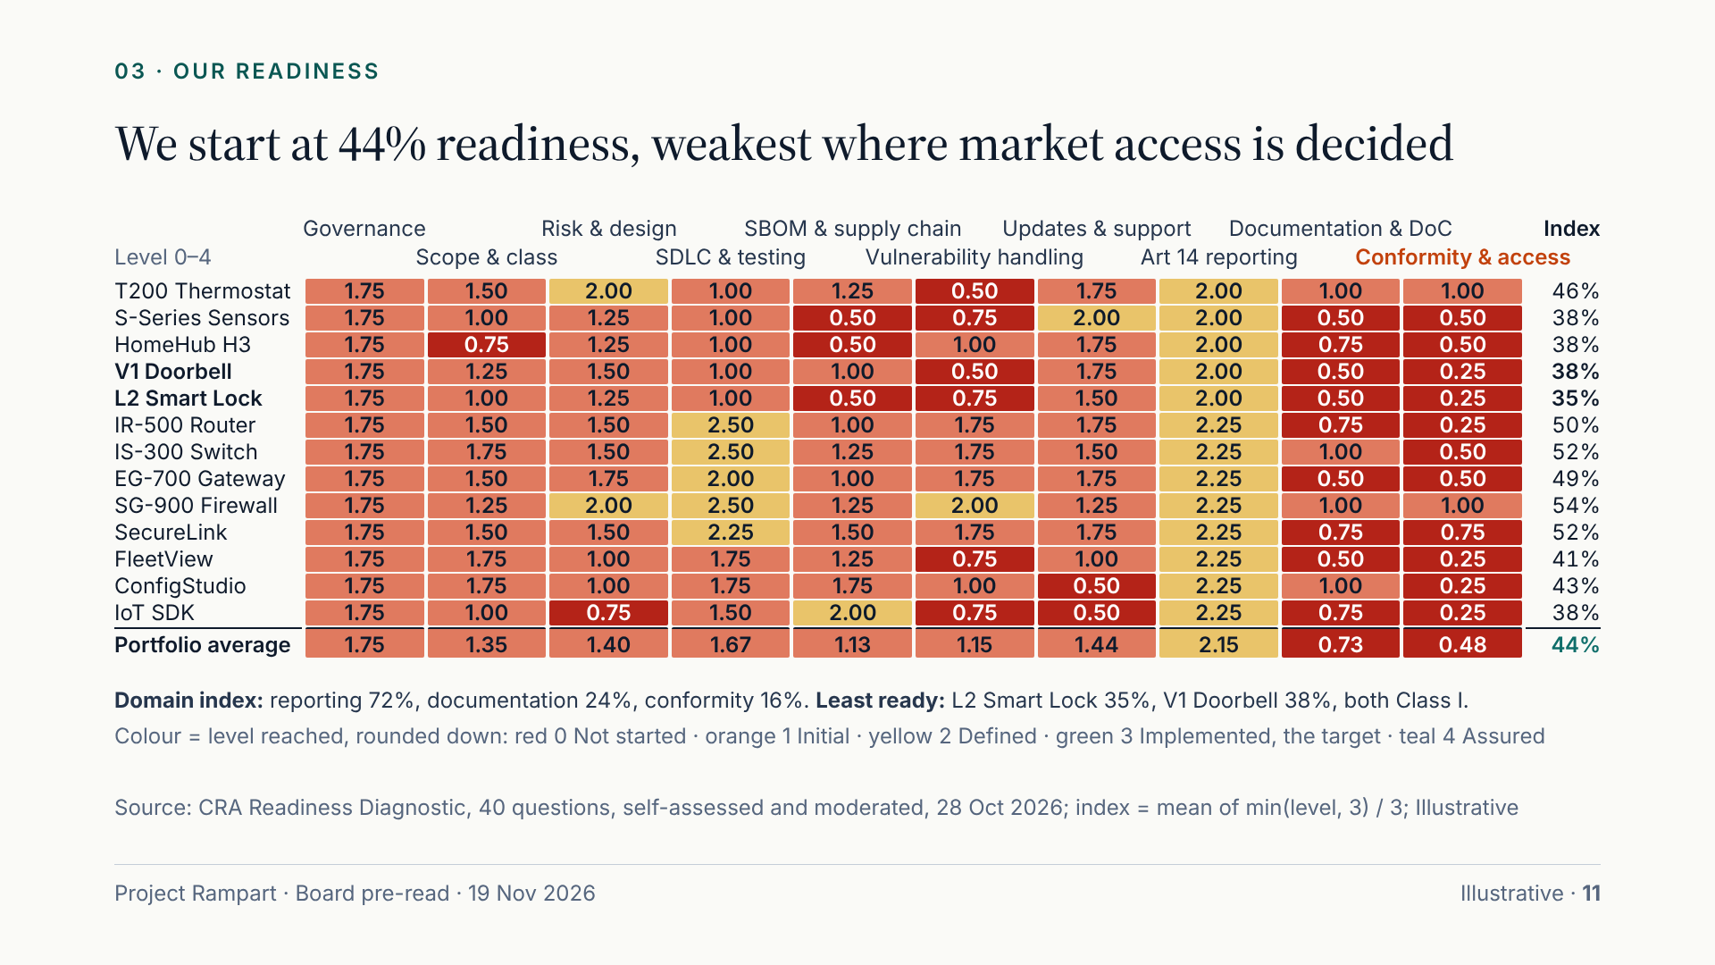
Notes:
We scored every family against 40 questions in ten domains, from 0 to 4, with level 3 as the target. The portfolio index is 44%. Reporting is our strongest domain at 72%, because we invested there first. The domains that decide market access are the weakest: documentation and declarations at 24%, conformity and market access at 16%. The industrial families, built on an IEC 62443 process, lead at around 50%. The two Class I home products, the L2 lock at 35% and the V1 doorbell at 38%, are among the least ready and face the hardest route.

Slide 12
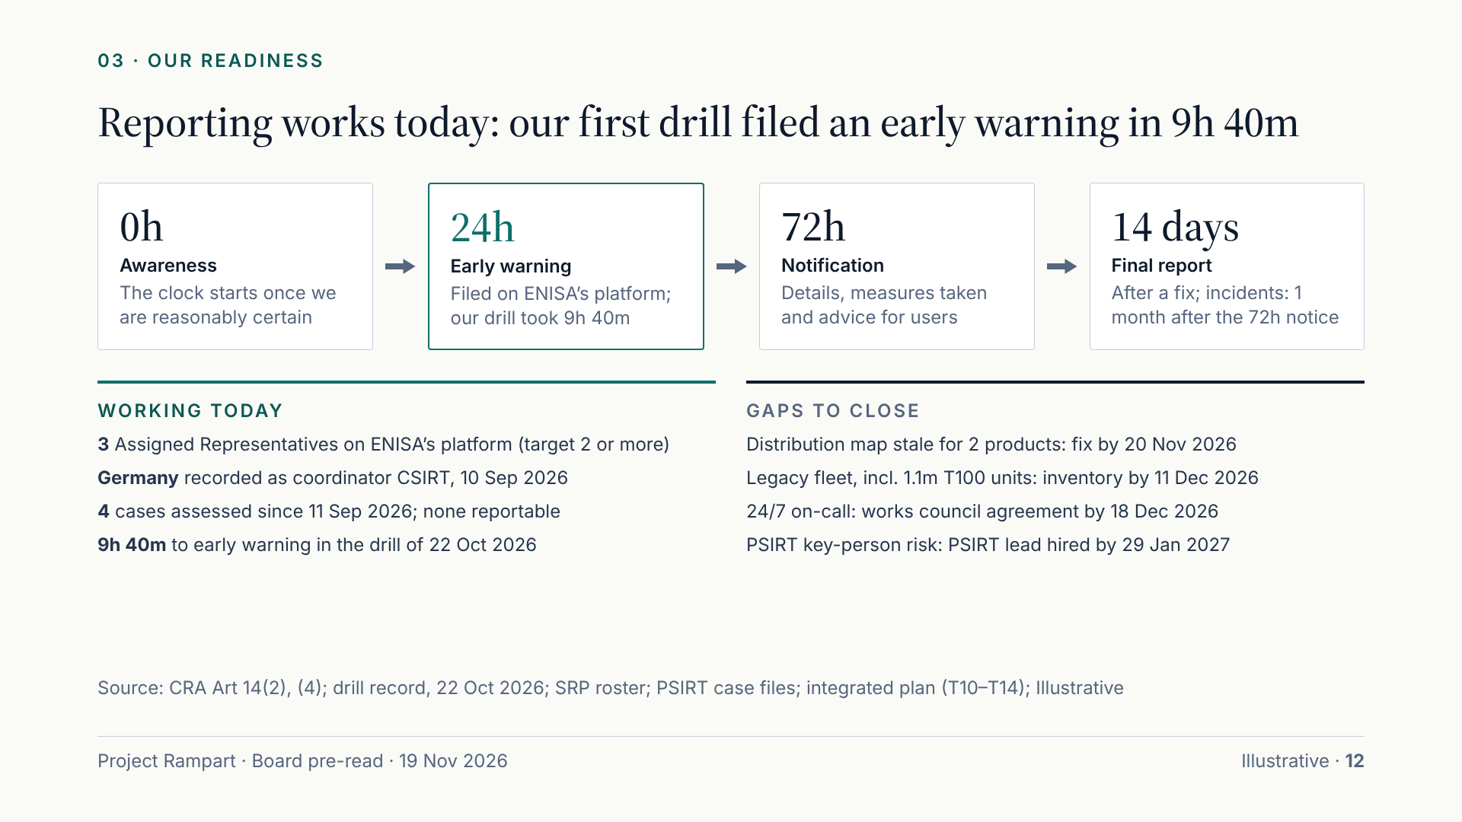
Notes:
Reporting is the one obligation already in force, and it is where we are strongest. We registered on ENISA’s Single Reporting Platform in September with three representatives and recorded Germany’s CSIRT as our coordinator. Our first drill, an actively exploited vulnerability, produced an early warning in 9 hours 40 minutes against a 24-hour limit. Four real cases have been assessed; none was reportable. Gaps remain: our distribution data could not name the Member States for two products; the legacy fleet, including 1.1 million T100 thermostats, must be inventoried; 24/7 on-call needs works council agreement; and PSIRT depends on two people until the new lead is hired.

Slide 13
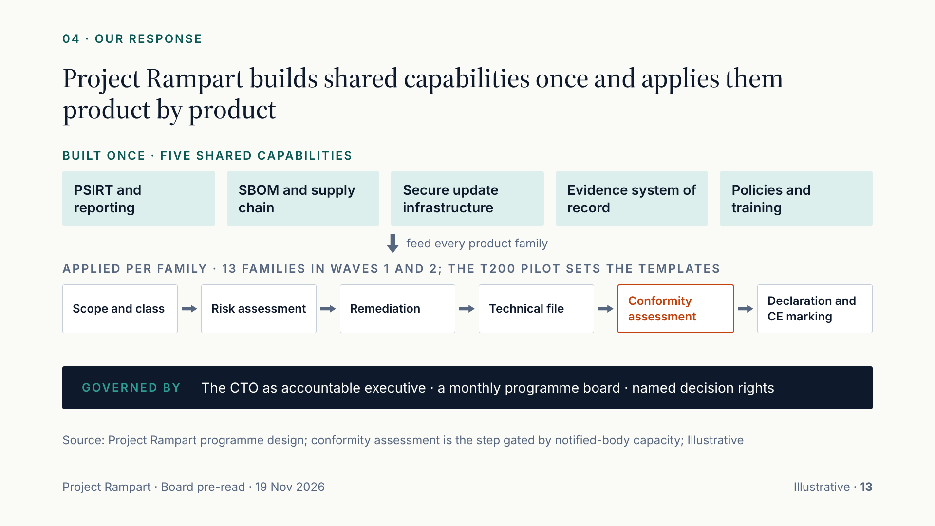
Notes:
Our response is an operating model, not thirteen separate projects. We build five shared capabilities once: the PSIRT and reporting process, the SBOM and supplier pipeline, hardened update infrastructure, a single system of record for evidence, and the policies and training that bind them. Each product family then runs the same six steps, from scope and class through risk assessment, remediation and the technical file to conformity assessment and the declaration. The T200 thermostat pilots the steps and produces the templates. Above it sit the CTO as accountable executive, a monthly programme board and named decision rights.

Slide 14
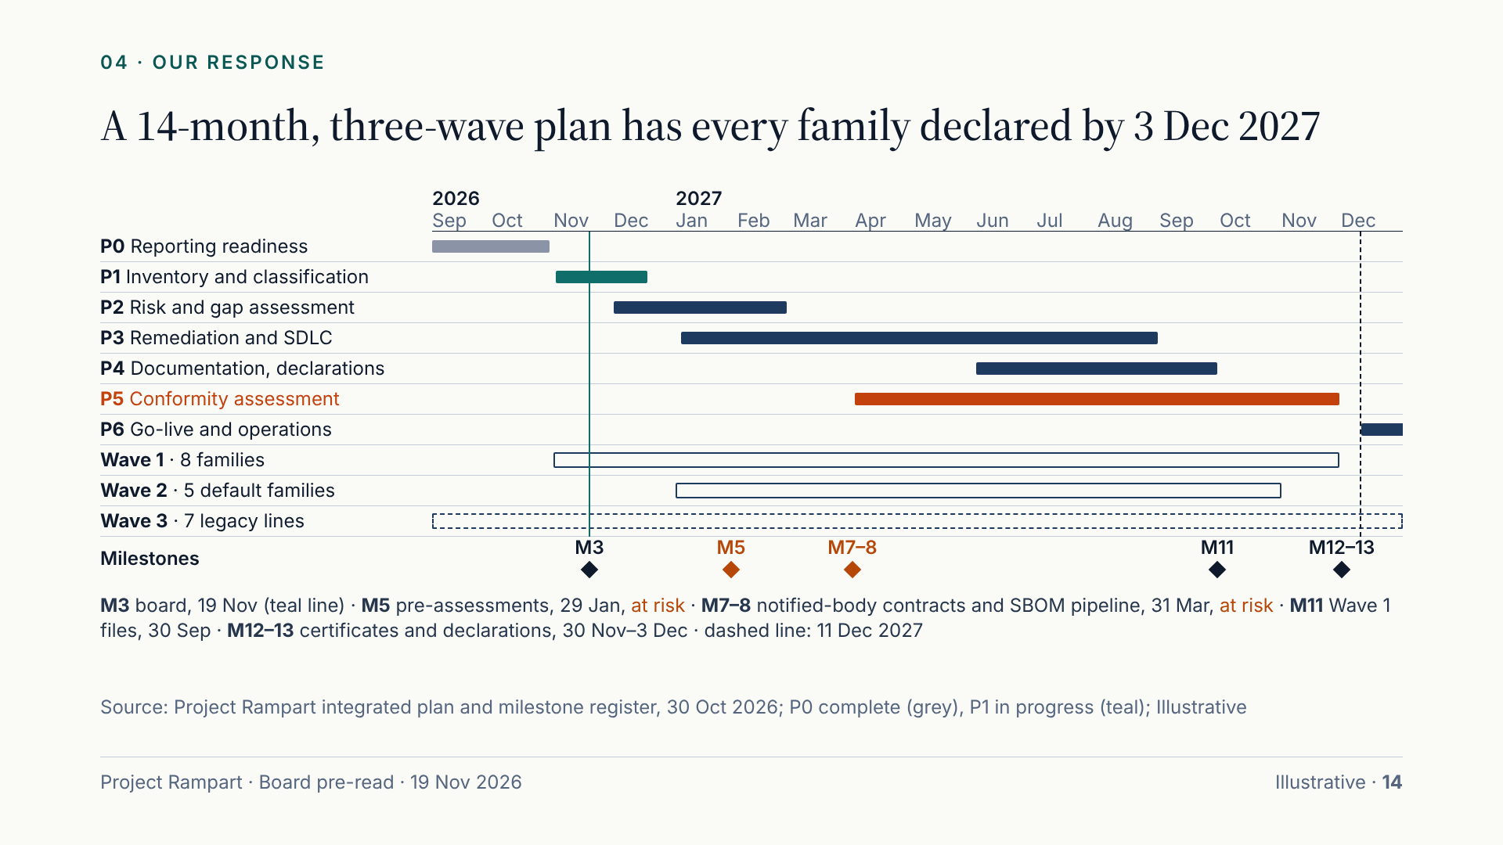
Notes:
The plan runs fourteen months from kick-off in October 2026. Phase 0, reporting readiness, is complete. Inventory and classification finish in December, and Wave 1 risk assessments by the end of February. Remediation is the longest phase, January to August 2027, followed by technical files. Conformity assessment runs from April to November and is the critical path: it depends on notified-body contracts by 31 March. Wave 1 carries the seven families that need a notified body plus the T200 pilot; Wave 2 reuses its templates for the default families; Wave 3 covers legacy lines. Three milestones are already at risk.

Slide 15
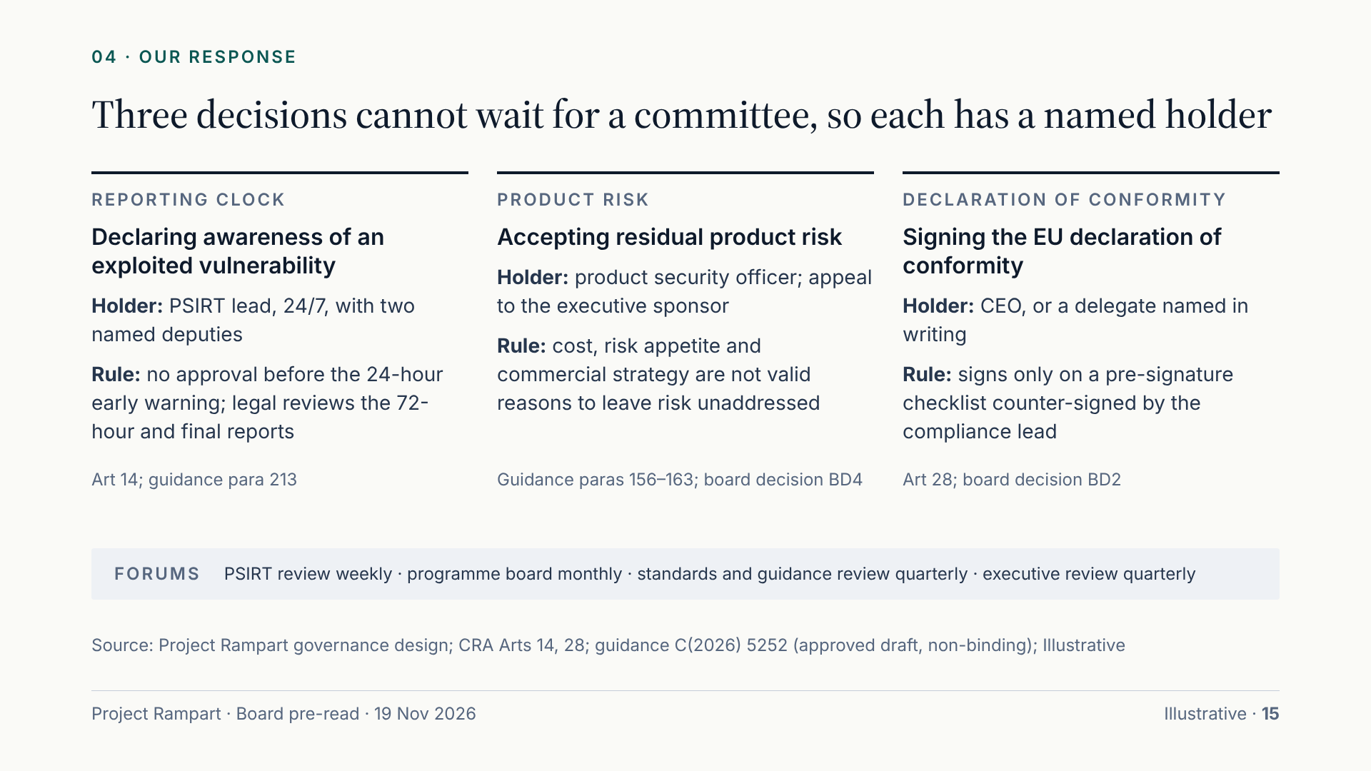
Notes:
Most programme decisions can wait for the monthly board. Three cannot. Declaring awareness of an exploited vulnerability starts a 24-hour clock, so the PSIRT lead or a deputy decides at any hour, without approval. Residual product risk is different from enterprise risk: the Commission’s guidance says cost, risk appetite and commercial strategy are not valid reasons to leave it unaddressed, so the product security officer decides, with appeal to the executive sponsor. The declaration of conformity is a legal statement; the CEO signs or delegates in writing, on a checklist the compliance lead counter-signs.

Slide 16
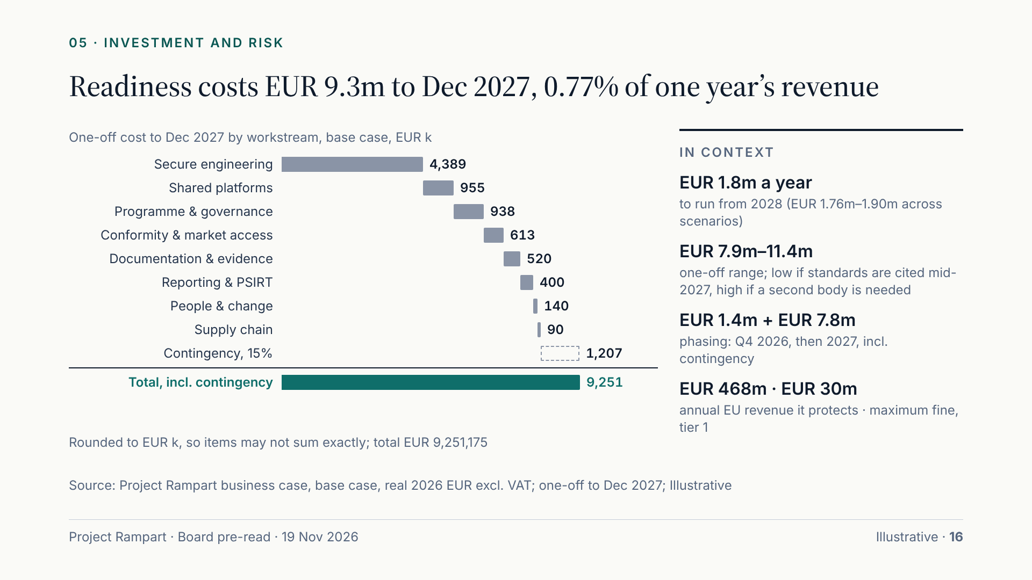
Notes:
The base case is EUR 9.25m to December 2027, including 15% contingency: EUR 1.4m this quarter and EUR 7.8m in 2027. Almost half, EUR 4.4m, is engineering remediation, testing and risk assessments, sized at 26.2 FTE-years of remediation. Shared platforms cost under EUR 1m. From 2028 running costs are EUR 1.8m a year, mainly testing, the programme core and the PSIRT. The range is EUR 7.9m if harmonised standards are cited by mid-2027, to EUR 11.4m if notified-body scarcity forces a second body and premium fees. The one-off is 0.77% of one year’s group revenue, against EUR 468m of annual EU revenue that depends on it.

Slide 17
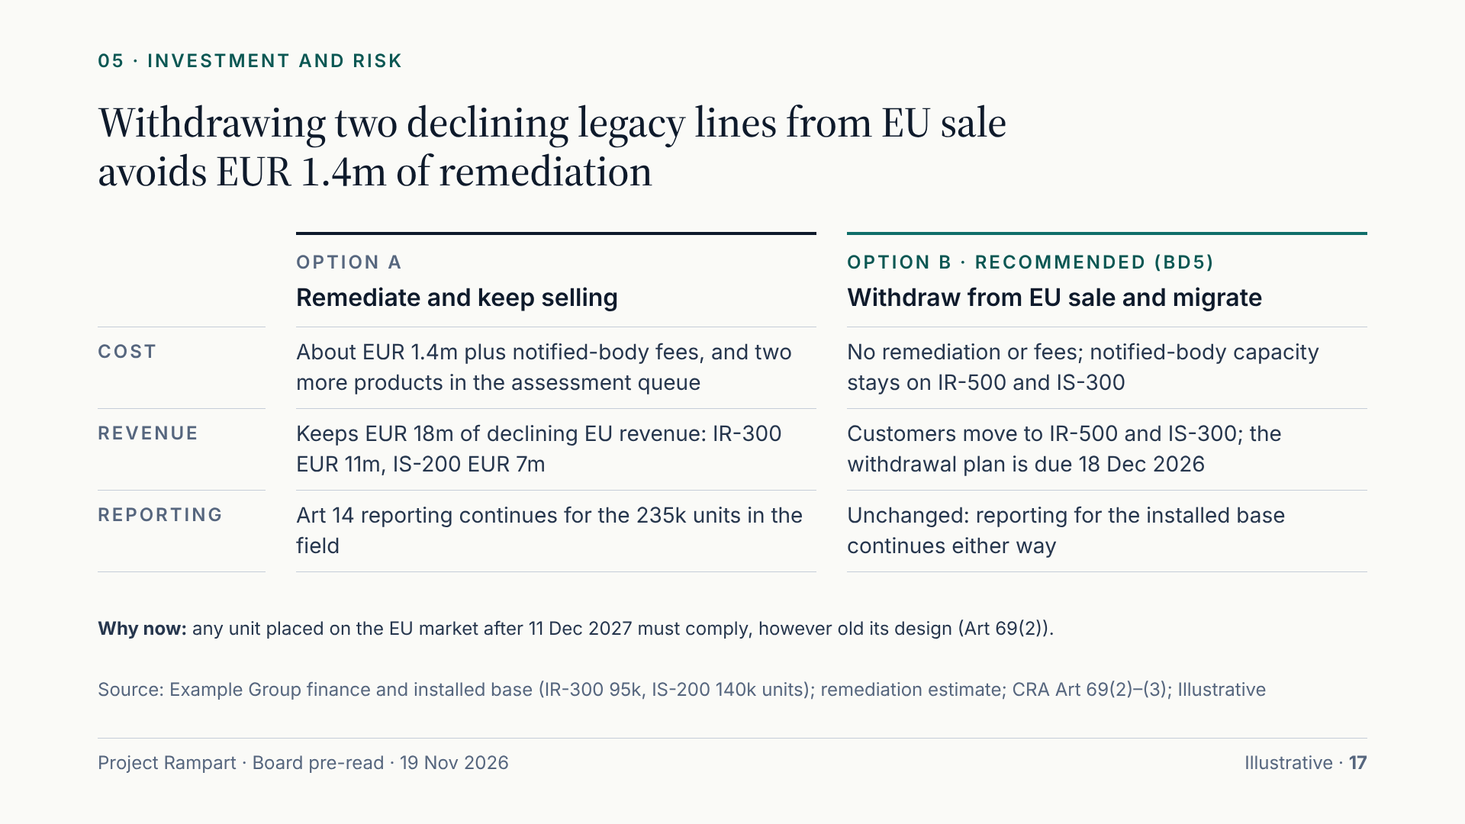
Notes:
Two legacy industrial lines are still sold in the EU: the IR-300 router to two OEM customers and the IS-200 switch as a low-cost option. The CRA judges each unit when it is placed on the market, so any unit sold after 11 December 2027 must meet the essential requirements, and as a router and a switch both would need a notified body. Remediation would cost about EUR 1.4m plus fees and would compete for the scarce assessment slots our current products need, to protect EUR 18m of declining revenue. We recommend withdrawal and migration of customers to IR-500 and IS-300.

Slide 18
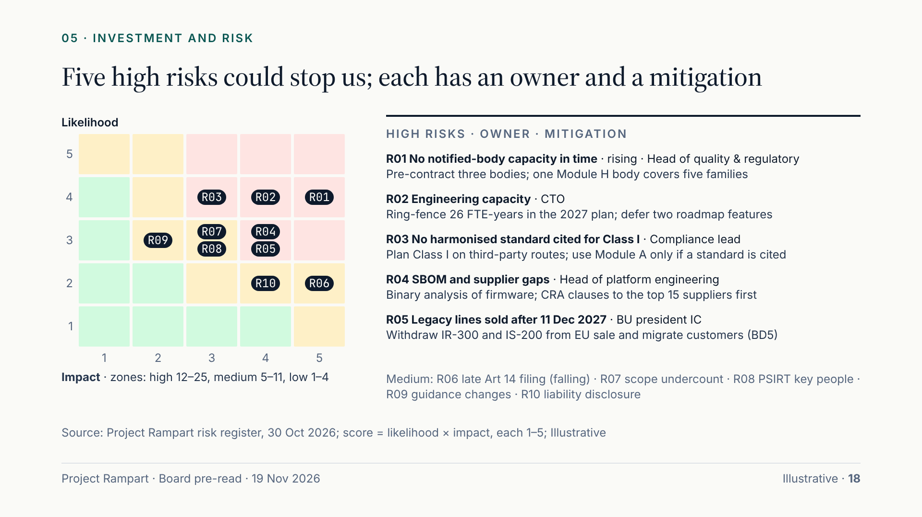
Notes:
Ten risks are on the register; five are rated high. The top one, and the only one rising, is notified-body capacity, which we mitigate through early pre-contracting and Module H. Second is engineering capacity: remediation competes with the 2027 roadmap for the same engineers, so the CTO proposes to ring-fence 26 FTE-years and defer two features. Third, no harmonised standard may be cited in time for Class I, so we plan on third-party routes. Fourth, supplier and SBOM gaps in firmware. Fifth, legacy lines still on sale, which BD5 resolves. Each risk has a named owner.

Slide 19
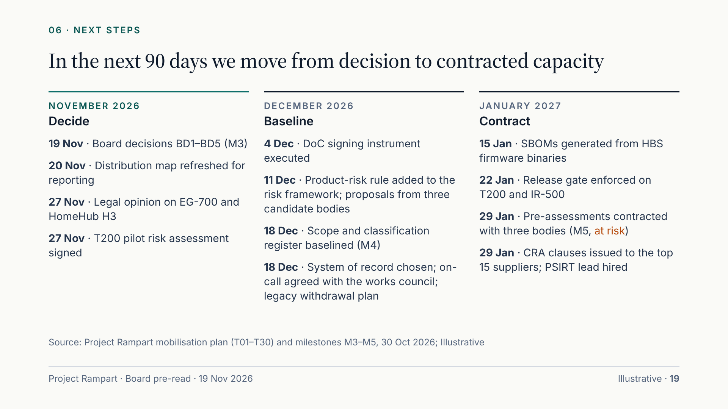
Notes:
If the board approves today, the next 90 days turn decisions into capacity. In November we close the reporting gap found in the drill and receive the legal opinion on the two borderline products. December baselines the scope register, executes the signing instrument, selects the system of record and, with the works council, settles 24/7 on-call. January is the test: pre-assessment contracts with three candidate bodies by 29 January, the release gate live on the first two release trains and CRA clauses with our top fifteen suppliers. We will report against these dates at each board.

Slide 20
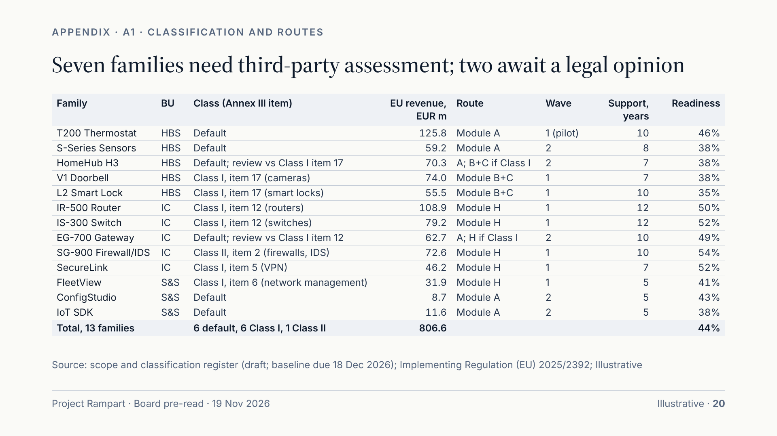
Notes:
For reference, this is the classification and route for every family. Seven are Class I or II and will use third-party assessment: Module H for the five industrial and software families, Module B+C for the doorbell and the lock. HomeHub H3 and EG-700 are provisionally default but under legal review against Class I categories; until the opinion lands we include them in notified-body capacity planning. Support periods range from five to twelve years and will be shown at the point of sale. The readiness column matches the diagnostic on slide 11.

Slide 21
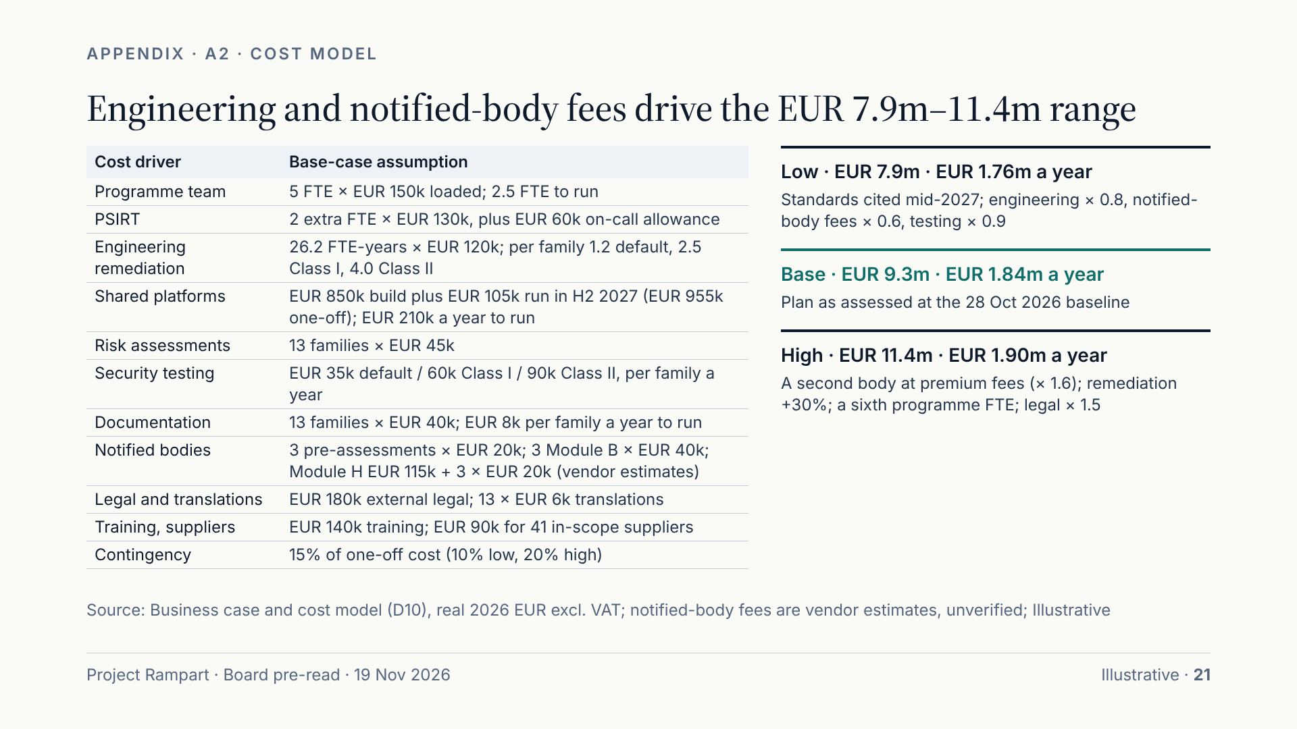
Notes:
The model is built bottom-up from eleven cost lines. The largest driver is engineering remediation: 26.2 FTE-years at a loaded EUR 120,000, sized by class. Notified-body fees are vendor estimates and the least certain input. The low case assumes harmonised standards are cited by mid-2027 and less remediation; the high case assumes scarcity forces a second body at premium fees, 30% more remediation and an extra programme FTE. Contingency rises from 10% to 20% across the cases. All figures are real 2026 euros excluding VAT; the full model is in the business case and cost model workbook (D10).

Slide 22
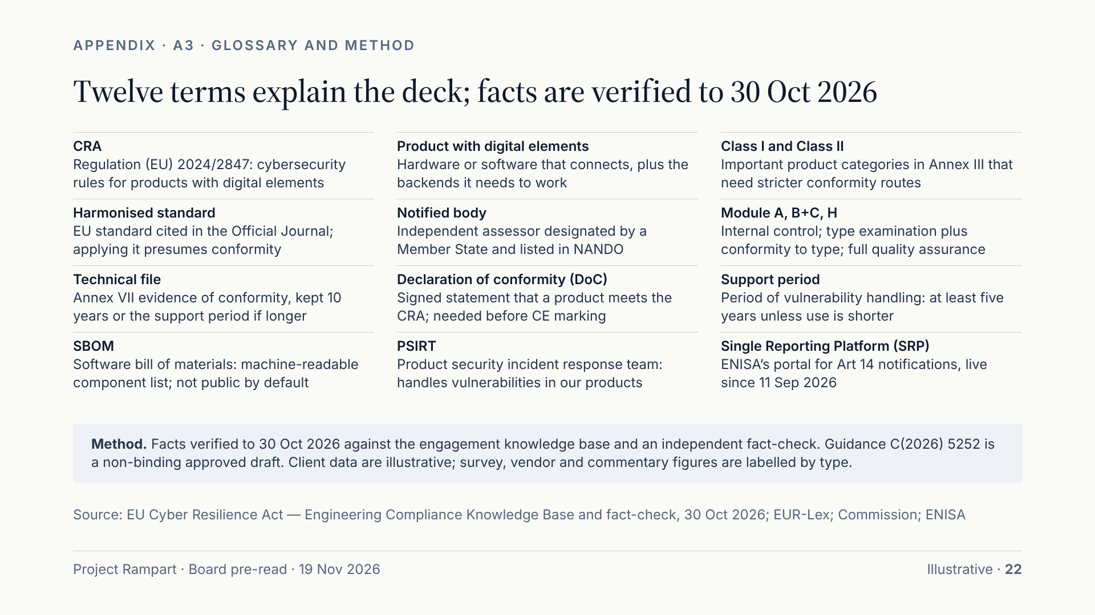
Notes:
The glossary defines the twelve terms used most in this deck. On method: every regulatory statement comes from the engagement knowledge base, which was fact-checked against primary sources to 30 October 2026; where a figure is commentary, a vendor statement or a survey, we say so. The Commission’s guidance is an approved draft and not binding, so decisions resting on it are recorded as such. Client figures are illustrative, drawn from the readiness diagnostic of 28 October and the business case. The Communication Pack (D05) and the programme dashboard (D09) use the same numbers.

